Slide 1

Indian Agriculture Analysis Using PowerBI
-Presented by Jagruti Yewale

Slide 2

OBJECTIVE OF PROJECT
The objective of an Indian agriculture analysis project with PowerBI is to employ data visualization and analytics for comprehensive insights into crop production, market trends, and policy impacts. This facilitates informed decision-making, optimizing resource allocation, and enhancing sustainability in agriculture. The project also aids in proactive risk management, supports market analysis for stakeholders, and fosters transparency within the sector. Ultimately, it aims to improve outcomes for farmers and contribute to the overall development of Indian agriculture.

Slide 3

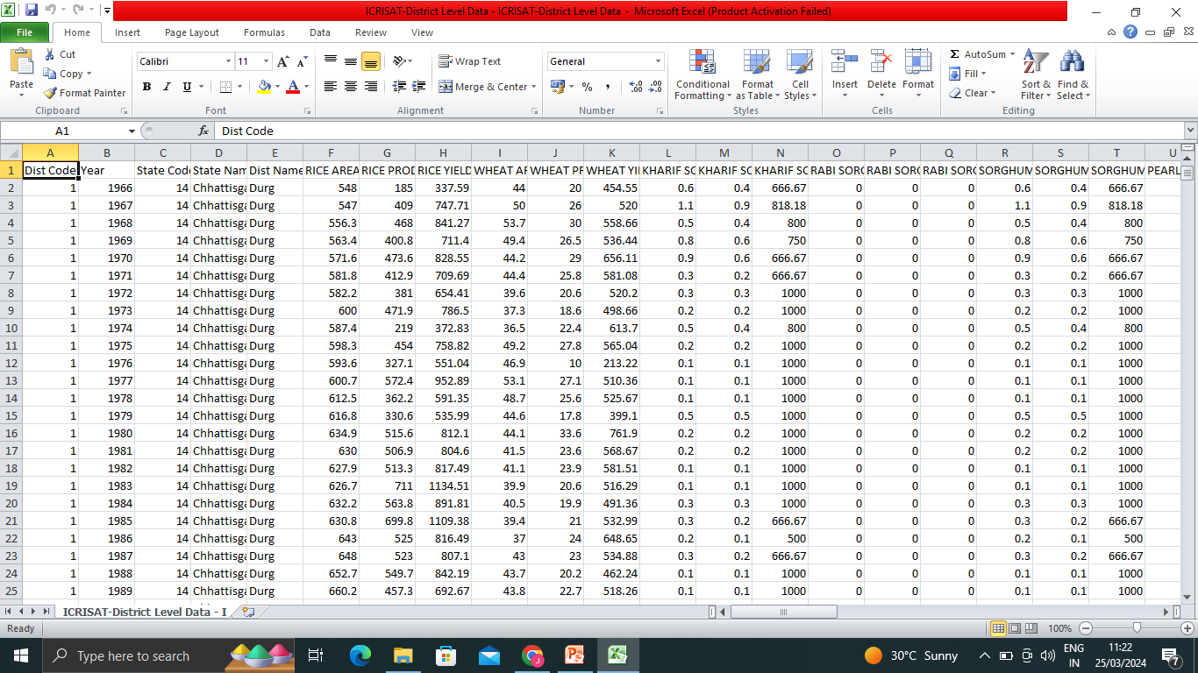
ABOUT DATASET- ICRISAT-District Level Data

Slide 4
Insights of Dataset
This dataset includes 16146 rows and 80 columns.
This summarizes the states and districts crops data on the basis of year with specified state code and district code.
It includes Area, Production and yields of Wheat, Rice, Kharif, Rabi, sugarcane, Pulses, shorgum, maize, Rapseed, mustured, Castore, linseed, etc.
It also includes information of Cotton, Potatoes, Onions, Fruits and Vegetables Production.
cultivation, production, and yields across different states or districts to highlight regional disparities and potential factors influencing them.
Exploring correlations between crop production, prices, and market demand to understand market dynamics and support decision-making by farmers and policymakers.

Slide 5
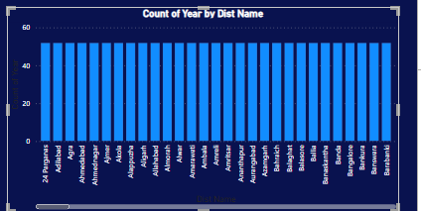
Data Exploration:
- Explore the dataset to understand the distribution of agricultural variables across districts and years.

Slide 6
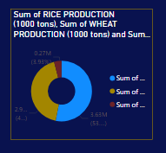
2. Crop-specific Analysis:
- Analyze the trends in the cultivation of major crops, including rice, wheat, and pulses, focusing on
changes in area, production, and yield.

Slide 7
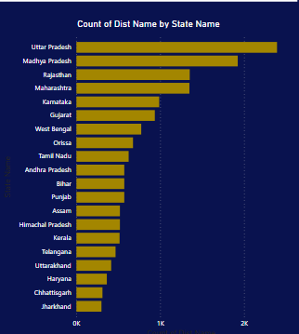
3. Regional Disparities:
- Identify disparities and variations in agricultural practices and outcomes across different districts and states.

Slide 8
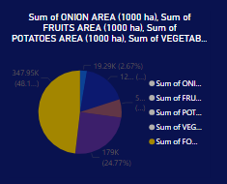
4. Fruits and Vegetables Analysis:
- Analyze the cultivation trends of fruits, vegetables, and their overall contribution to agricultural
practices.

Slide 9
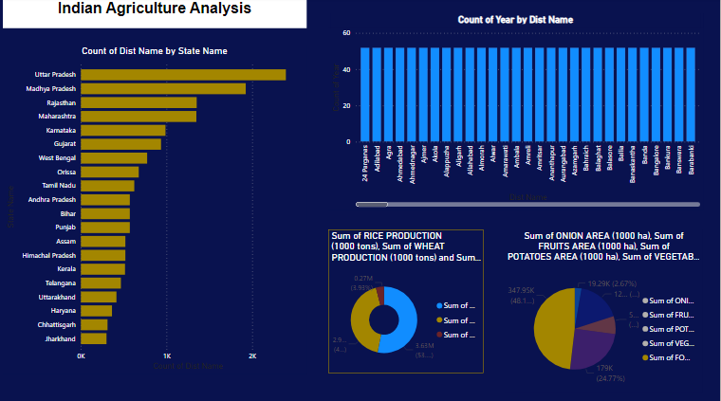
Complete PowerBI Dashboard

Slide 10
Insights of Projects
It Exploring the distribution of agricultural variables across districts and years can offer valuable insights into the dynamics of agricultural systems, inform policy decisions, and guide resource allocation efforts aimed at improving agricultural productivity and sustainability.
Analyzing trends in major crops like rice, wheat, and pulses can reveal shifts in cultivation practices, production levels, and yields over time. Insights may include identifying crop diversification trends, assessing the impact of policies or climate changes, and highlighting areas for targeted intervention to enhance agricultural productivity and sustainability.
Identifying regional disparities in agricultural practices and outcomes can reveal unequal access to resources, varying environmental conditions, and differing levels of agricultural development. Insights gained can inform targeted interventions, policy adjustments, and resource allocation strategies to address inequities and improve overall agricultural productivity and livelihoods across regions.
Analyzing cultivation trends of fruits and vegetables reveals shifts in agricultural practices, highlighting the importance of diversification for food security and nutrition. Insights may include identifying regions with potential for horticultural development, assessing market demand, and informing strategies to promote sustainable farming practices and enhance the contribution of fruits and vegetables to overall agricultural output.

Slide 11
Application of PowerBI in Aggriculture Fields
Power BI finds various applications in agriculture fields, including:
Data Visualization:
Creating interactive dashboards and reports to visualize agricultural data such as crop yields, weather patterns, and market trends.
Decision Support:
Providing insights for farmers, policymakers, and agricultural businesses to make informed decisions on crop selection, resource allocation, and market strategies.
Precision Agriculture:
Integrating IoT sensors and satellite imagery data with Power BI to monitor crop health, soil moisture levels, and pest infestations for precision farming.
Supply Chain Management:
Analyzing supply chain data to optimize logistics, improve inventory management, and ensure timely delivery of agricultural products.
Risk Management:
Identifying and mitigating risks such as crop diseases, adverse weather events, and market volatility through data-driven analysis and predictive modeling.

Slide 12
Application of PowerBI in Aggriculture Fields
Farm Performance Monitoring:
Tracking key performance indicators (KPIs) such as crop yield per acre, input costs, and profitability to optimize farm operations and improve overall efficiency.
Market Analysis:
Analyzing market trends, consumer preferences, and pricing dynamics to identify opportunities for market expansion and product diversification.
Compliance and Reporting:
Generating regulatory compliance reports, including pesticide usage, environmental impact assessments, and farm subsidies, to ensure adherence to regulations.
Research and Development:
Supporting agricultural research initiatives by analyzing experimental data, conducting simulations, and exploring correlations between variables.
Sustainability Monitoring:
Assessing the environmental impact of agricultural practices, such as water usage, greenhouse gas emissions, and soil health, to promote sustainable farming methods.
Overall, Power BI enables stakeholders in the agriculture sector to leverage data analytics for better decision-making, improved efficiency, and sustainable agricultural practices.

Slide 13
Conclusion
This project provides an opportunity to gain hands-on experience in agricultural data analysis and visualization using Power BI, contributing valuable insights to enhance agricultural practices and
decision-making in India.
Overall, analyzing this dataset using PowerBI can provide valuable insights into the dynamics of Indian agriculture, which can inform strategic planning, policy formulation, and resource management efforts in the sector.

Slide 14
Thanks for watching

